Slide 1
Physics 2 – Mar 22, 2019
Get out p140 #19-29 for Hmk Check
P3 Challenge – A gas that has a volume of 28 liters, a temperature of 45 ⁰C, and an unknown pressure has its volume increased to 34 liters and its temperature decreased to 35 ⁰C. If you measure the pressure after the change to be 2.0 atm, what was the original pressure of the gas?
Today’s Objective:
Internal Energy
Assignment:
Ch 3.2, p141, #30-32
Agenda
Boltzmann Distribution
Average K.E.
Internal Energy

Slide 2
Homework Ans only
27. a. 0.03 mole b. 1.81 x 10²² molecules c. 0.872 g
28. a. 0.0227 m³ b. 0.176 kg/m³ c. 1.41 kg/m³
29. same density
19. 1.46 x 10⁹ Pa
20. 88 g CO₂
21. 10.0 min
22. (see graph on board)
23. 10 atm
24. a. 981 Pa b. 1.217 x 10²² molecules c. 0.0728 m³
25. 0.0454 m³ ; 56 g
26. 1.04 x 10⁵ Pa

Slide 3
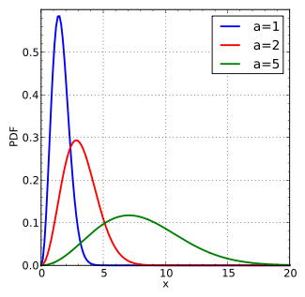
Boltzmann Distribution
Boltzmann distribution is a result of statistical mechanics that describes how the random particle speeds of an ideal gas are distributed.
Note: Statistical mechanics is the application of statistics to the gas particle behavior.
Unsymmetrical distribution. Always a finite probability at any high speed, but zero at 0 speed.
The ranking of temperature for the three graphs are Blue<Red<Green.
Notice the peak location increases and lowers and the speeds spread out as temperature increases.

Slide 4
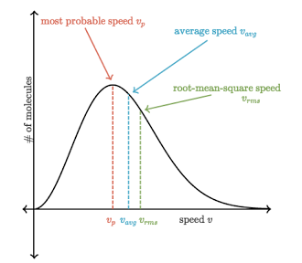
“Typical” Particle Speed
Three types of “average speed” values for the particles of an ideal gas
most probable speed (mode) left red peak
average speed (mean) center blue
c (v_{rms}) = “root mean square” speed corresponds to average kinetic energy (temp) right green peak
Best indication of temperature is c because temperature IS average kinetic energy
IB assumes c represents all three.
Unfortunate that IB uses c for both v_{rms} and the speed of light. Beware: This is NOT c = 3 x 10⁸ m/s

Slide 5
Average Kinetic Energy
The average K.E. is related to the average speed, c, where m_{a} is the atomic mass of a single gas particle.
Note on units: 1 u = 1.66 x 10⁻²⁷ kg
From the ideal gas law and statistical mechanics:
And other basic relationships: M = molar mass
$m=Nm_{a}$ $d=\frac{m}{V}$

Slide 6
Internal Energy of a Gas
If the average kinetic energy of one particle of gas is 3/2 k_{B}T, and you have a sample containing N particles, the internal energy of the sample is N times the average kinetic energy. $U=N\overline{E_{K}}$
From this, and recalling the definitions of k_{B} and moles you can derive the other possible expressions for the internal energy of a gas, U.
Problem solving is either of the plug and chug variety, or is algebra derivation of formulas types. So know these two fundamental relationships. (Only the first $\overline{E_{K}}{=\frac{3}{2}k}_{B}T$ is in the IB packet.)
Notice that both average E_{K} and U only depend on T in K.

Slide 7
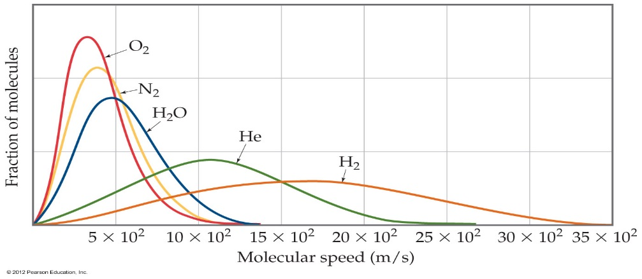
Root Mean Square Velocity
Because kinetic energy depends on both mass and velocity, two gasses with the same kinetic energy can have different v_{rms} if they have different molar masses. (you will derive this for homework)
Where M is the molar mass of the gas. Compare the distributions for all of the gasses at a common temperature. The heavier molecules move slower for the same kinetic energy.
Root mean square velocity depends on the molar mass of the gas.
Ex: Calculate the root mean square speed of a hydrogen molecule at STP.

Slide 8
Exit Slip - Assignment
Exit Slip-
What’s Due? (Pending assignments to complete.)
Ch 3.2, p141, #30-32
DOWNLOAD Engineering Physics Text B!!!!
What’s Next? (How to prepare for the next day)
Start studying for the U6 Thermal Physics Test on the second Tuesday after spring break. (April 9)

